Slide 1




The Ultimate Gen-Z & Millennial Shopping Trend-Finder
Our Team
Group 20
What they prefer to shop for & what it means for businesses?
Harsha Patimidi
Jhalak Surve
Tejaswini M
Ekta Bhatia

Slide 2
Why this topic?
01
02
04
03
Millennials
Generation Z
Currently the largest consumer base in the U.S.
To-be largest consumer base in the U.S.
Implications for businesses
Spending Power
Finding out what attracts this huge consumer base can help businesses come up with the right products and strategies
They have a significant spending power at their fingertips

Slide 3
Conducted a survey and gathered real-time information from the Millennials and Gen Zs
Who are they?
Generation
Z
The
Millennials
1997-2012
1981-1996

Slide 4
Design Considerations and Approach
1
2
3
4
Consumers and Expenses
Most common expenses
Social Media
Shopping online or in-person
Added social media as an entity because it has a huge impact on shopping trends
There are 2 ways of purchases which are online and physical store, so included them in our design
Consumer and expense are our two major entities, because our aim is to analyze the shopping trends.
Included clothing, food, travel, electronics, and entertainment as expense subtypes.

Slide 5
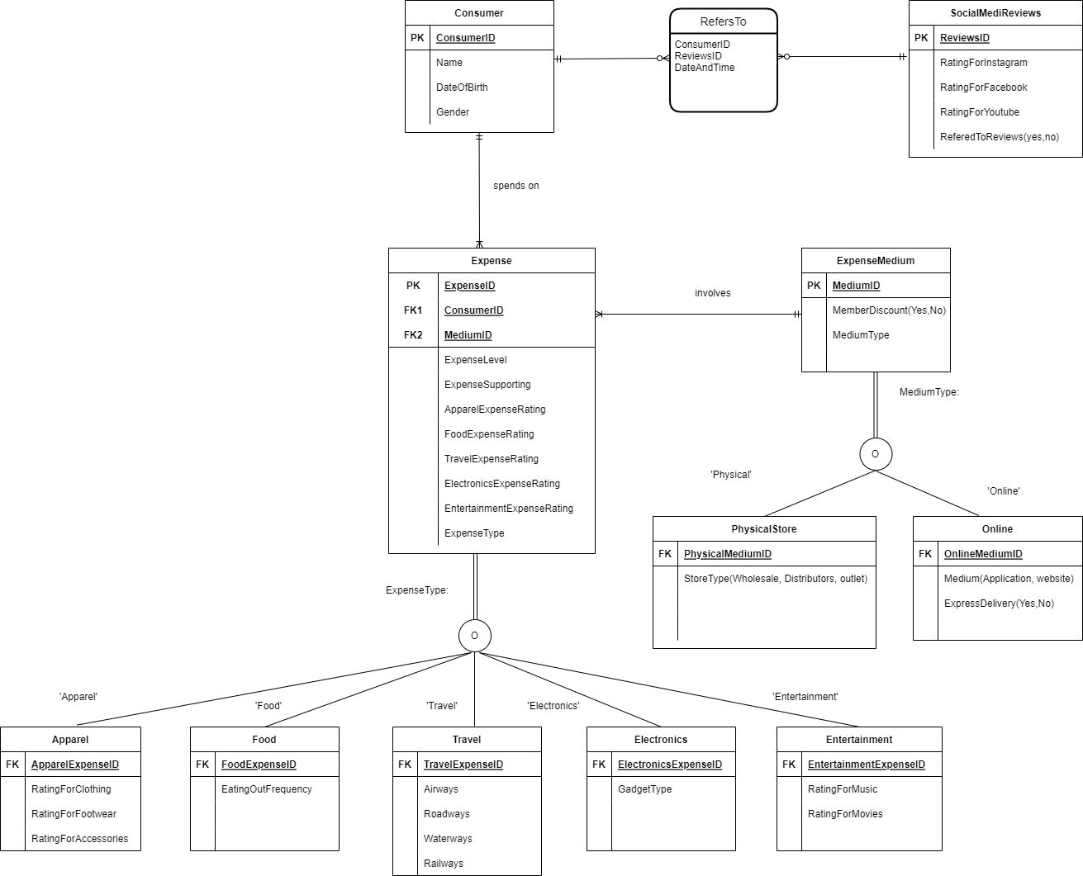
ER Diagram

Slide 6
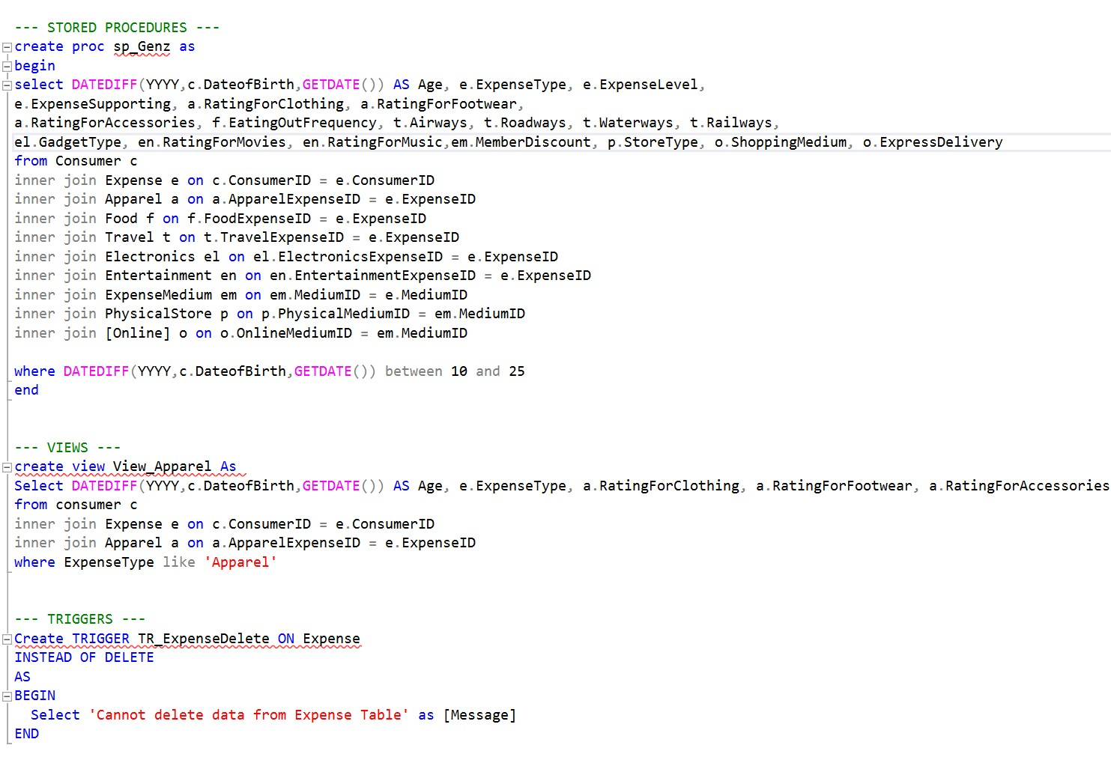
DDL
Statements

Slide 7
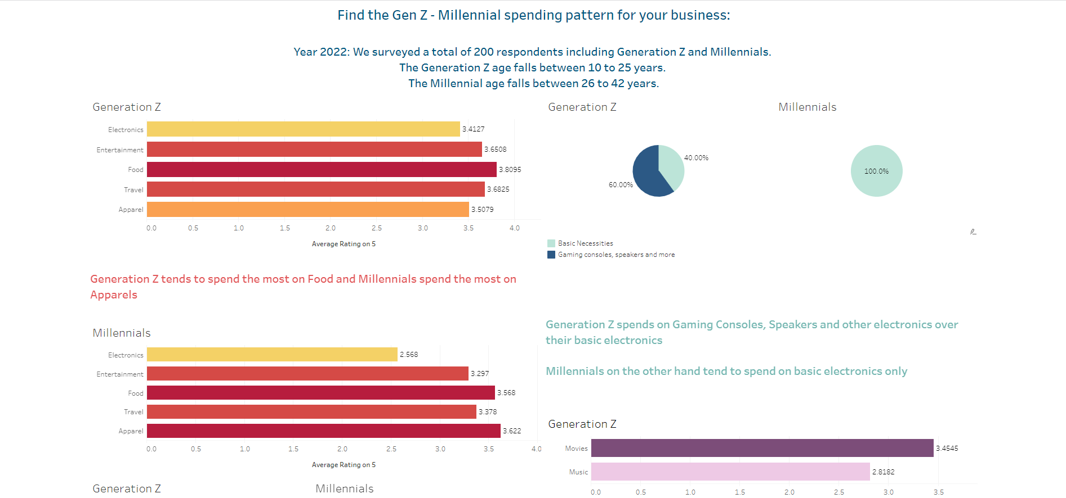
Millennials
Used Tableau to analyze the data
Our Tableau Dashboard
Generation Z
[Part of the dashboard]
Spend the most on Apparel
Spend the most on Food

Slide 8
Top Conclusions
Gadgets
Comfort & Food
Sustainability & mode of purchase
Gen Z spends on fancy electronics while Millennials like sticking to basics
They prefer spending on Comfort over Luxury and eat outside twice or more in a week
They prefer sustainable, in-store purchases over online ones
Discounts
Stores
Reviews
They try new brands because they offer discounts and do not like to pay more for faster delivery
They prefer shopping from Outlet Stores and Mobile Apps as opposed to
Websites & Distributors
They like to research and refer to reviews before making any purchase & YouTube is their most used app

Slide 9
What it means for the business?
A few takeaways..
Good to have a Mobile App
If not, an easy-to-use website since anything outdated does not go well with the Generation
Make sure your brand supports sustainability
YouTube being the most used implies that it’s all about the content, so kick up the brand visibility
Keep releasing discounts and offers to attract new customers

Slide 10
Thank You

